Slide 1

Markov Chain
Part 4

Slide 2
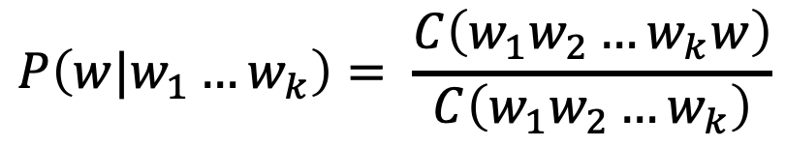
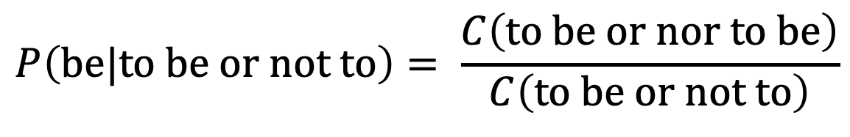
Estimating an n-gram language model
Given a large database, count the frequency of ngrams
Then given any word w and pattern w₁w₂...w_{k} (k < n), we have

Slide 3
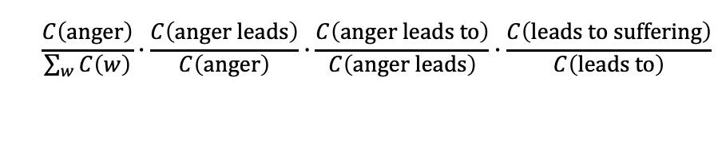
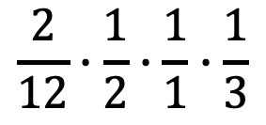
Example (Trigram language model)
fear leads to anger. anger leads to hate. hate leads to suffering.
fear: 1
fear leads: 1
fear leads to: 1
leads: 3
leads to: 3
leads to anger: 1
leads to hate: 1
leads to suffering: 1
to: 3
to anger: 1
to hate: 1
to suffering: 1
anger: 2
anger leads: 1
anger leads to: 1
hate: 2
hate leads: 1
hate leads to: 1
suffering: 1
P(“anger leads to suffering”) =
P(anger)*P(leads|anger)*P(to|“anger leads”)* P(suffering|“anger leads to”)
=
P(anger)*P(leads|anger)*P(to|“anger leads”)* P(suffering|“anger leads to”)
=
=
= 0.028

Slide 4
Problem
What if an n-gram never appeared in the past?
Does it mean it will never appear in the future?
If any component is zero, then the whole product is zero!

Slide 5
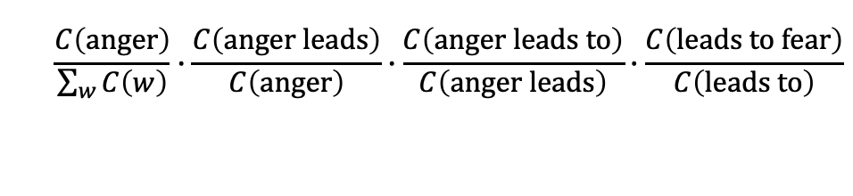
Example (Trigram language model)
fear leads to anger. anger leads to hate. hate leads to suffering.
fear: 1
fear leads: 1
fear leads to: 1
leads: 3
leads to: 3
leads to anger: 1
leads to hate: 1
leads to suffering: 1
to: 3
to anger: 1
to hate: 1
to suffering: 1
anger: 2
anger leads: 1
anger leads to: 1
hate: 2
hate leads: 1
hate leads to: 1
suffering: 1
P(“anger leads to fear”) =
P(anger)*P(leads|anger)*P(to|“anger leads”)* P(fear|“anger leads to”)
=
P(anger)*P(leads|anger)*P(to|“anger leads”)* P(fear|“anger leads to”)
0
=
= 0

Slide 6
Smoothing
Assign a small probability to n-grams that have never appeared
So we can calculate the probability of any out-sample sequence
If we assign probabilities to unseen events, that means we have to distract those of observed events
This process is called “smoothing”

Slide 7
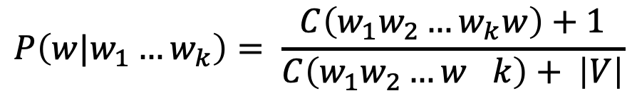
Add “One” Smoothing
Laplace smoothing
For every word w in the vocabulary, add the count of (k+1)-gram ending with w by 1 so every word has appeared after w₁...w_{k} for at least once.
Many other smoothing methods available in natural language processing

Slide 8
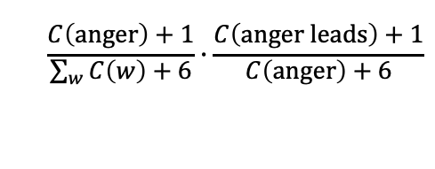


Example (Trigram language model)
fear leads to anger. anger leads to hate. hate leads to suffering
fear: 1
fear leads: 1
fear leads to: 1
leads: 3
leads to: 3
leads to anger: 1
leads to hate: 1
leads to suffering: 1
to: 3
to anger: 1
to hate: 1
to suffering: 1
anger: 2
anger leads: 1
anger leads to: 1
hate: 2
hate leads: 1
hate leads to: 1
suffering: 1
P(“anger leads to fear”) =
P(anger)*P(leads|anger)*P(to|“anger leads”)* P(fear|“anger leads to”)
=
P(anger)*P(leads|anger)*P(to|“anger leads”)* P(fear|“anger leads to”)
=
=
V = {fear, leads, to, anger, hate, suffering}
= 0.0013

Slide 9
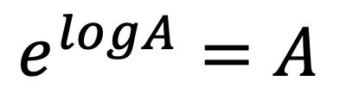
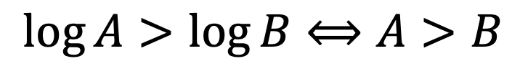
Trick: do calculation with logarithm
When sequence is long: avoid multiplying many probs.
Do it in log space: mathematically equivalent (why?)
Avoid underflow & loss of precision
Faster
P(“dark dark dark dark … dark”) = P(“dark”)¹⁰⁰ = 0.00008¹⁰⁰ = ?
100
log (P(“dark dark dark dark … dark”))= log(P(“dark”)¹⁰⁰ ) = 100 * log(0.00008) = -943.3

Slide 10
Other Markovian models
Markov Chain is a powerful, yet simple model for sequence modeling
Other models with Markov assumption are also widely used for various types of sequence-like data

Slide 11
Credits: Qiaozhu Mei, Ph.D., Professor of Information
© Faculty Presenter Qiaozhu Mei
Except where otherwise noted, this work is licensed under CC BY-NC 4.0
Notes:
End of part 4 video

